Slide 1
Basic Intro To Arduino’s https://tinyurl.com/2018DHWSRes
Presented by SUTD IEEE Student Branch

Slide 2
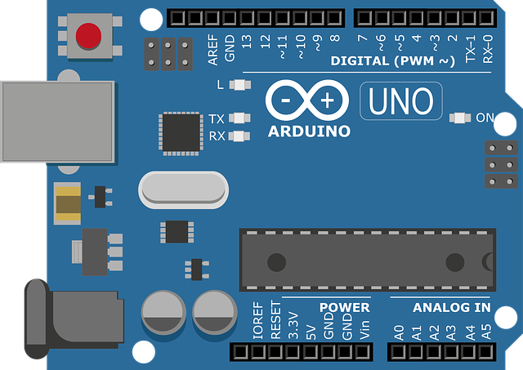
Arduino
ATmega328P
Open source platform for Microcontrollers
Easy to program/ reprogram the ATmega328P Microcontroller in C++
Loads of built in functions for easy manipulation of ports!

Slide 3

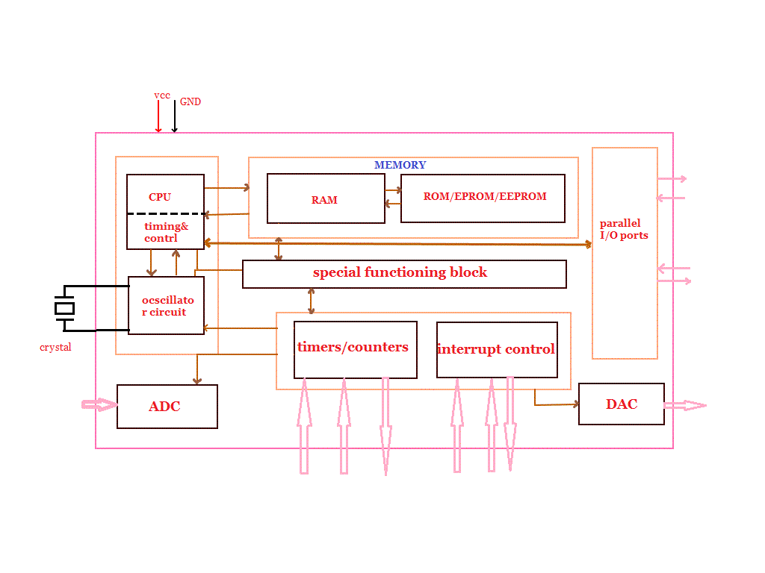
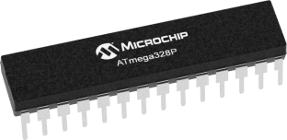
Arduino – ATMEGA328P
Refer to http://www.circuitstoday.com/basics-of-microcontrollers for more info!

Slide 4
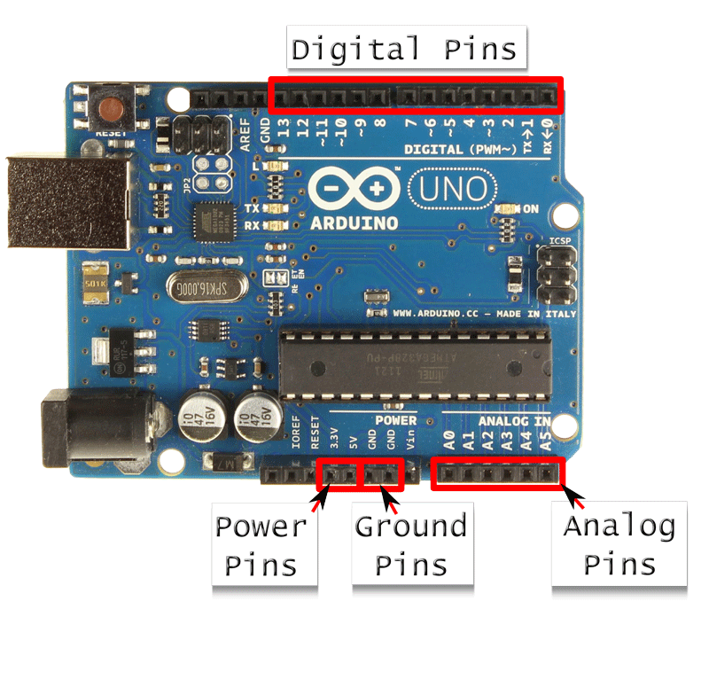
Arduino – what can it do?
Read ‘Inputs’ and set ‘Outputs’
2 types on ‘Inputs’ and 2 types of ‘Outputs’

Slide 5
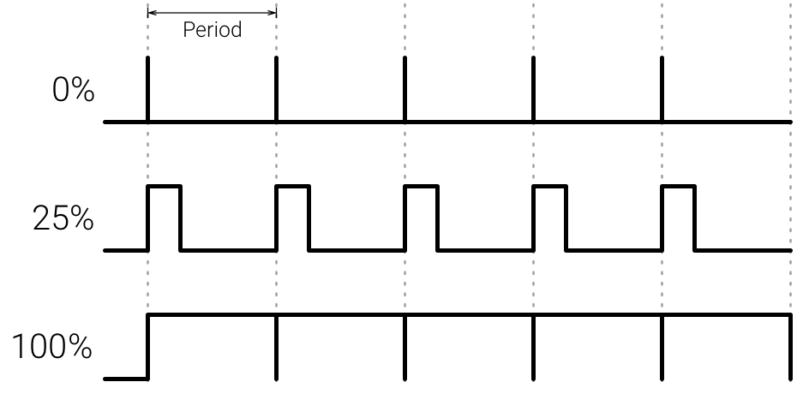
Arduino – what can it do?
Inputs
Digital
ON – 5V / HIGH
OFF – 0V / LOW
Analogue
Continuous value between 0V-5V
Outputs
Digital
ON – 5V / HIGH
OFF – 0V / LOW
Pulse with Modulated (PWM)
Square Wave with variable duty cycle

Slide 6

Arduino – What can it do?

Slide 7
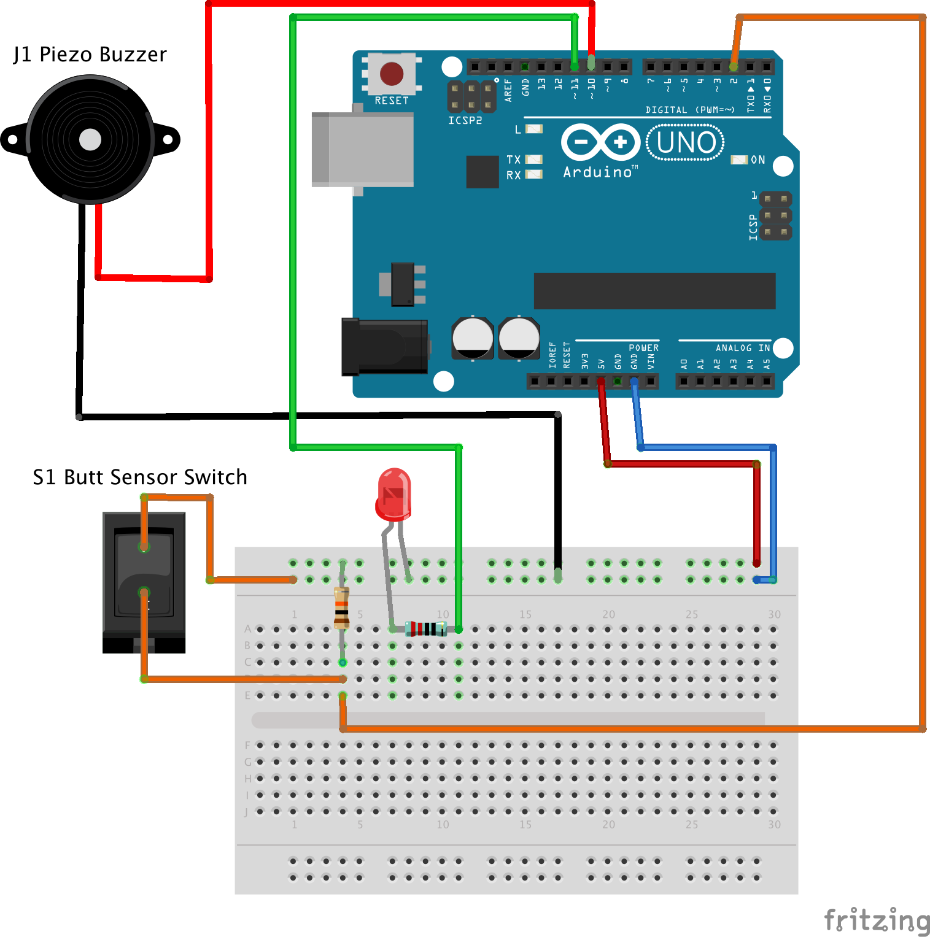
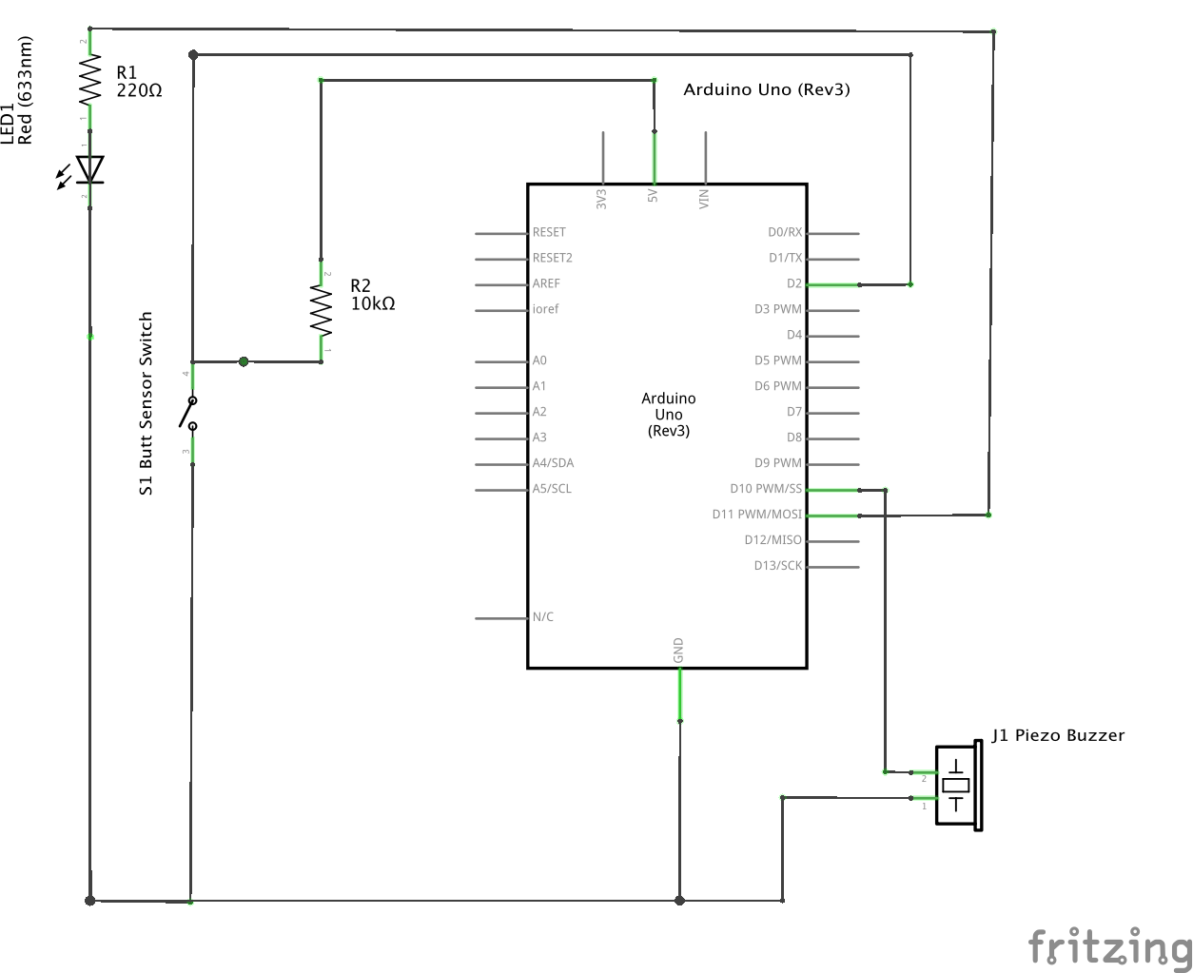
Arduino and Electronics
Pictorial Diagrams!
Uses images of how the components look in real life
Shows how the connections physically look
Schematic Diagrams!
Uses standard symbols to represent electronic components
Shows exact connections and offers more detail

Slide 8
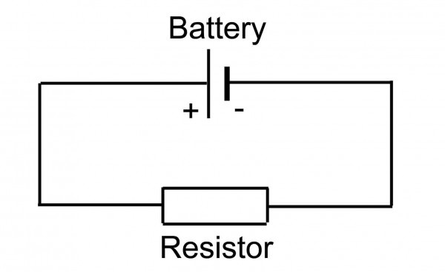
Arduino and Electronics: Quick Physics Recap
+
LOAD
-
GND

Slide 9
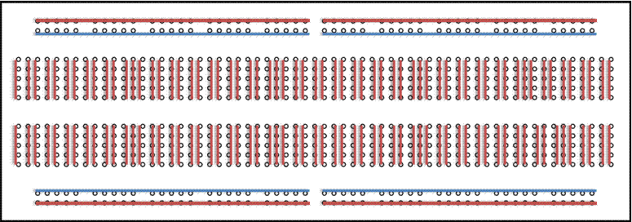
Arduino and Electronics: Breadboard
Columns Connected
Rows Connected
Not Connected

Slide 10
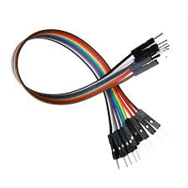
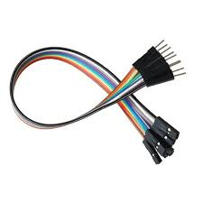
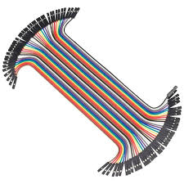
Arduino and Electronics: Jumper Wires
Male-Male Wire
Male-Female Wire
Female-Female Wire

Slide 11
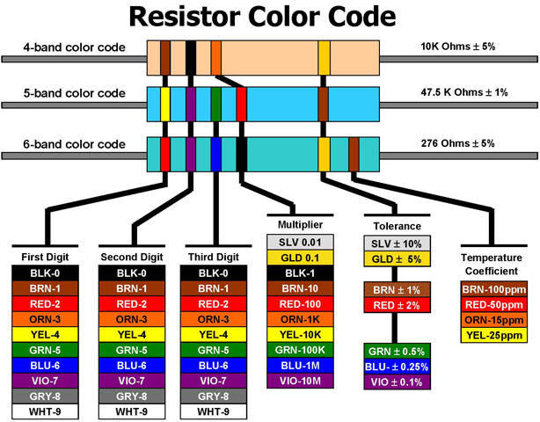
Arduino and Electronics: Resistors
Resistors are one of the most used components
So remember this table!
(Or just search for a resistor calculator, like a sane person!)

Slide 12
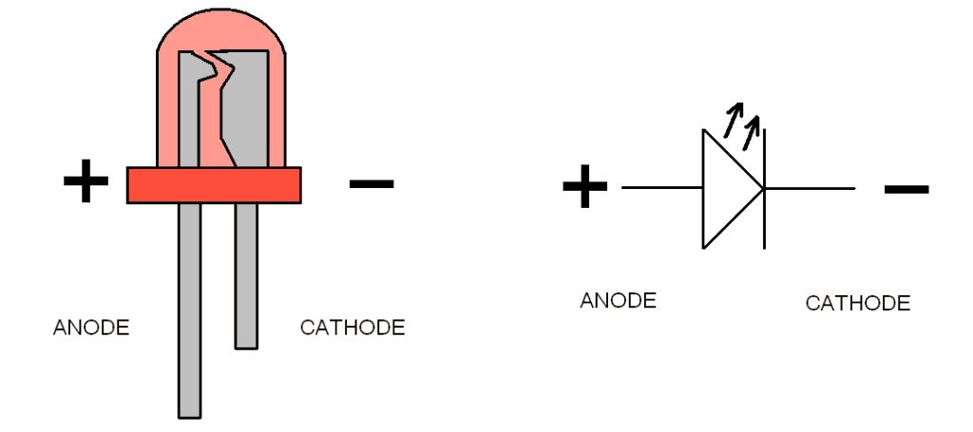
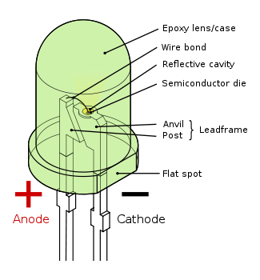
Arduino and Electronics: LED’s
LED’s are polarized – only work one way
+ve Leg to HIGH, -ve Leg to GND
How do you identify which is which?
Short leg is -ve OR
-ve end has a flat side

Slide 13
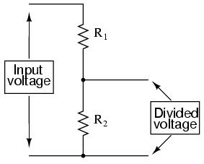
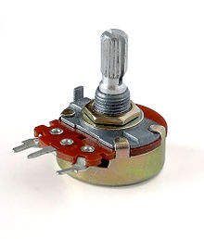
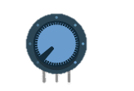
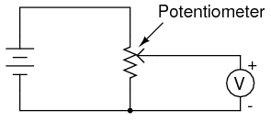
Arduino and Electronics: Potentiometers
Variable resistor
Allows you to divide voltage potential.
Arduino can measure voltage at center pin.
5v
Gnd
Divided Voltage

Slide 14
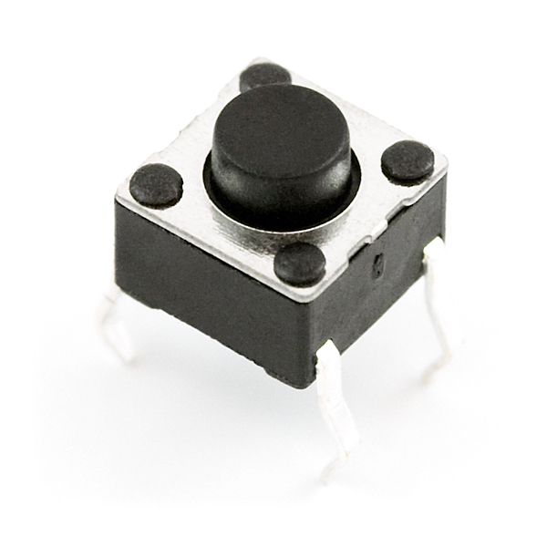
Arduino and Electronics: Buttons
Digital Input
Either 1 or 0
End 2
End 3
End 1
End 4

Slide 15
Great Lets Play!
… but first, we need to understand how to program the Arduino.

Slide 16
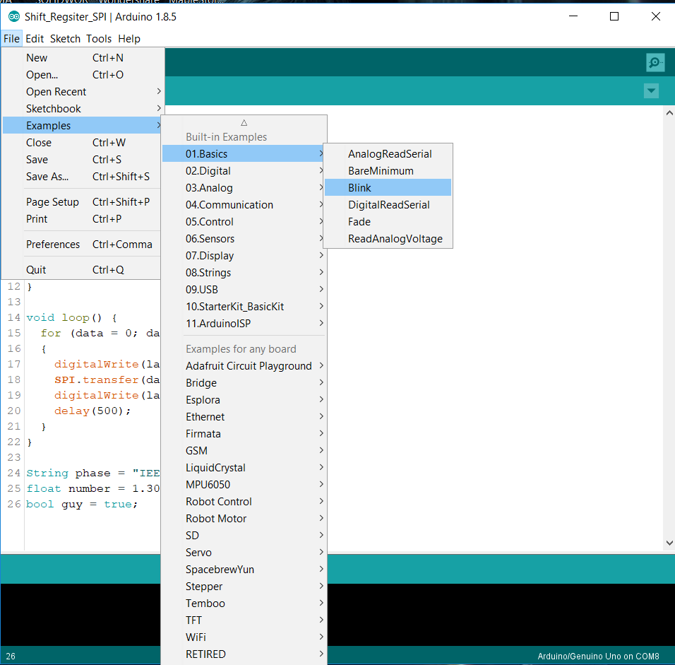
Uploading to the Arduino
Open up the blink example sketch!
There is a built in LED on the Arduino board so we will not have to make any circuit (yet)

Slide 17
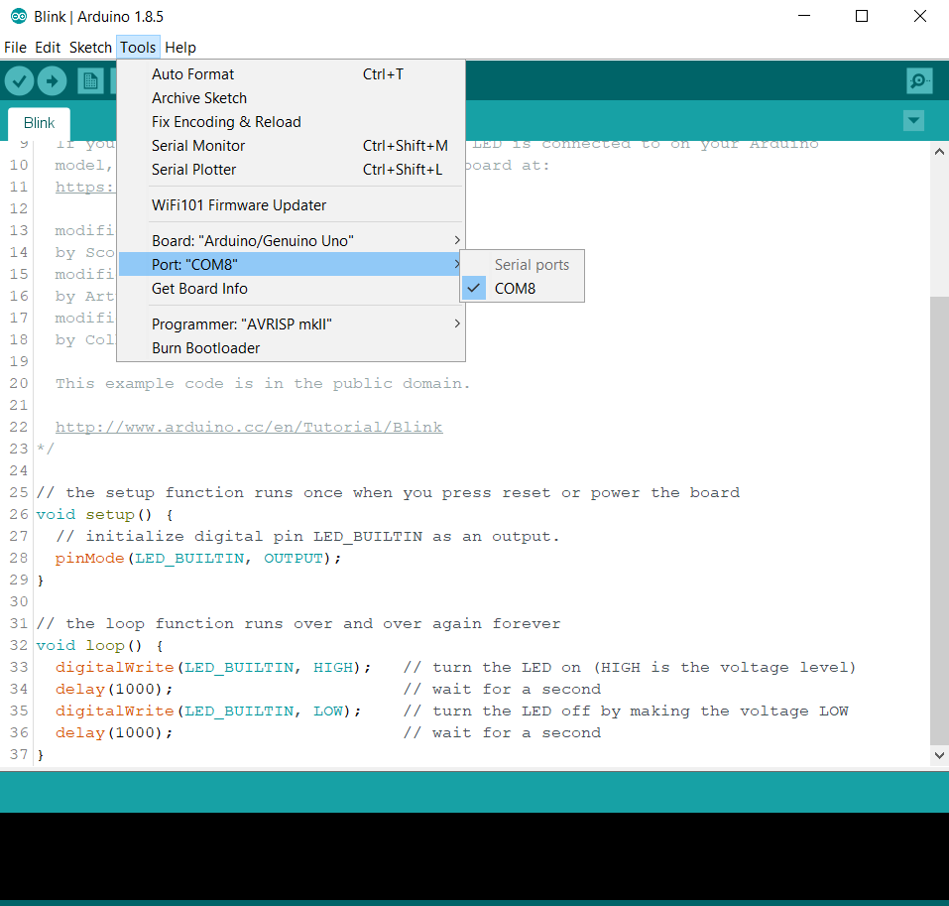
Uploading to the Arduino
Select the port that access Arduino!
If there are multiple ports:
Unplug Arduino, check port
Plug in Arduino, pick the new port

Slide 18
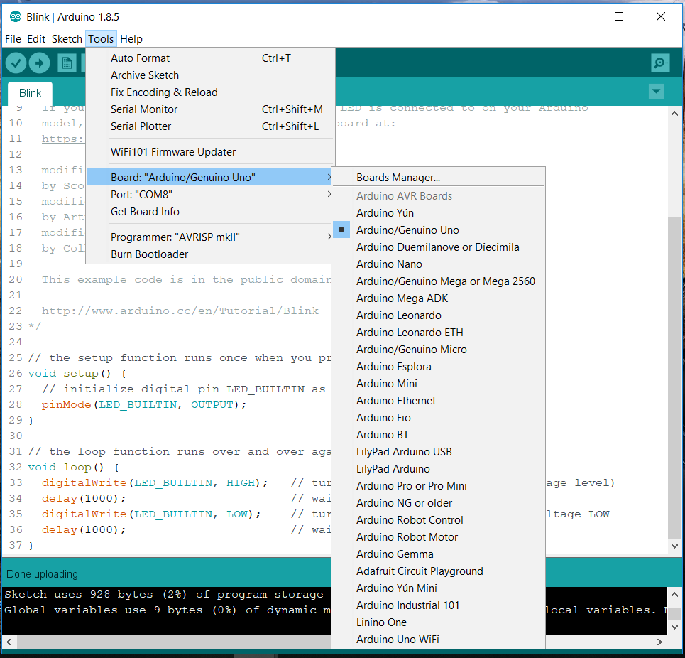
Uploading to the Arduino
Check the board selected
We are using the Arduino Uno

Slide 19
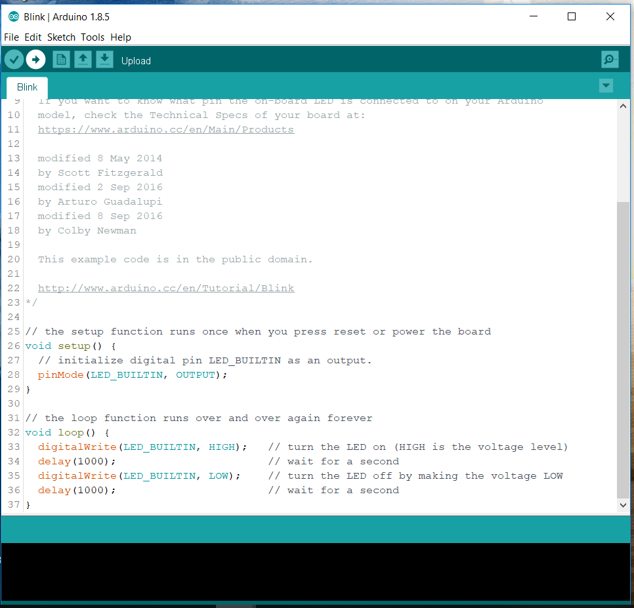
Uploading to the Arduino
Verify
Upload

Slide 20
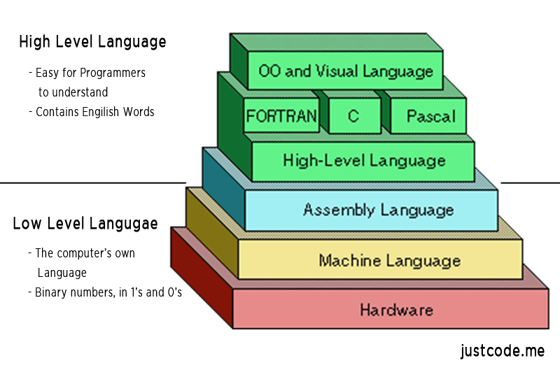
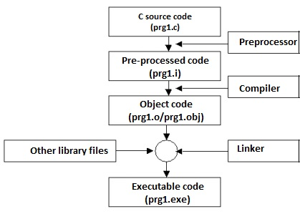
Coding Basics
Many different programming languages, some low-level, some high-level.

Slide 21
Coding Basics
Many general concepts apply across (most) languages (at least high-level ones)
Many languages: C, C++, C#, Python, Java, MatLab, Go, JavaScript, etc…
What is a program?
It generally defines a set of instructions to be carried out by the computer or system that is intended to produce a given output, perhaps given an input. How this can be done is discussed on the next slide.

Slide 22
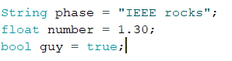
Coding Basics: General Concepts
Variables
Containers for data
Types:
Int, Float, Bool(ean), Double, Char, String, and many more
Functions
Just like mathematical functions. Give an input (sometimes), and get an output (sometimes)
Loops
Do-While, While, For
Control statements: break, continue, etc…
(type of variable) (name of variable) = (assignment);

Slide 23
Coding Basics: General Concepts
Conditionals
if (CONDITION) … then … else …
Operations
Bitwise
|, &, >>, <<, ^, ~
Logical
<, >, <=, >=, !=, ==, &&, ||
Arithmetic
+, -, /, *, ^, %

Slide 24
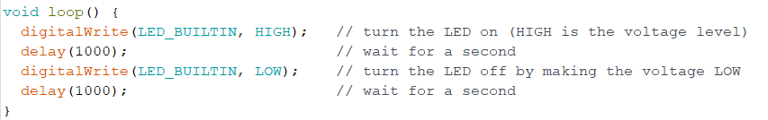
Coding Basics: C++
{ … } – Curly brackets define a block of code that is executed
Variables defined within the brackets are only accessible in those brackets and any brackets inside (Local and global scope)
( … ) – Round brackets enclose parameters
; – Every line of code terminates with a semi-colon – denotes end of ‘sentence’!
// – Single line comment
/* … */ – Multi line comment

Slide 25
Programming for the Arduino
void setup () {
….
….
} It runs the code once upon start-up
void loop () {
….
….
}
It runs the code continuously after setup.
Arduino uses C++
Two main functions:
setup()
Runs once
loop()
Runs again and again until something goes wrong or the Arduino turns off

Slide 26
Programming for the Arduino – Arduino Specific Functions
void setup()
void loop()
delay()
pinMode()
Serial.begin() and Serial.println()
digitalRead() and digitalWrite()
analogRead() and analogWrite()

Slide 27
Programming for the Arduino – Arduino Specific Functions
delay(x)
Stops execution of any code for x milliseconds.
delay(500); // Delay for 500ms
Serial
Serial.begin()
Serial.print()
Serial.println()

Slide 28
Programming for the Arduino – Arduino Specific Functions
Serial.begin(x)
Begins connection via the serial protocol to the attached device (e.g. your computer)
Sets communication speed at x bits/s
Common speed: 9600 bits/s
Set speeds: 9600, 14400, 19200, 38400, 57600, 115200, 128000, 256000, etc.

Slide 29
Programming for the Arduino – Arduino Specific Functions
Serial.print()
Uses the serial protocol to send characters to your computer
Serial.print(“Hello world);
Serial.print(35);
Serial.println()
Exactly the same as Serial.print() but adds a ‘\n’ (newline) character at the end of your ‘sentence’
Serial.println(“Hello world);

Slide 30
Programming for the Arduino – Arduino Specific Functions
pinMode(x, MODE)
Tells the Arduino that pin x is going to be an OUTPUT / INPUT
pinMode(3, OUTPUT);
pinMode(A0, INPUT);
digitalRead(x)
Reads value on input pin x – returns 0 or 1
int inputValue = digitalRead(3);
digitalWrite(x, MODE)
Writes value on output pin – HIGH or LOW
digitalWrite(3, HIGH)

Slide 31
Programming for the Arduino – Arduino Specific Functions
analogRead(x)
Reads analog value on input pin x – returns 0 – 1023
int inputValue = analogRead(A0);
analogWrite(x, y)
Writes value on output pin x – with a value of y (0 – 255)
digitalWrite(3, HIGH)

Slide 32
Alright, Time for some Arduino!

Slide 33
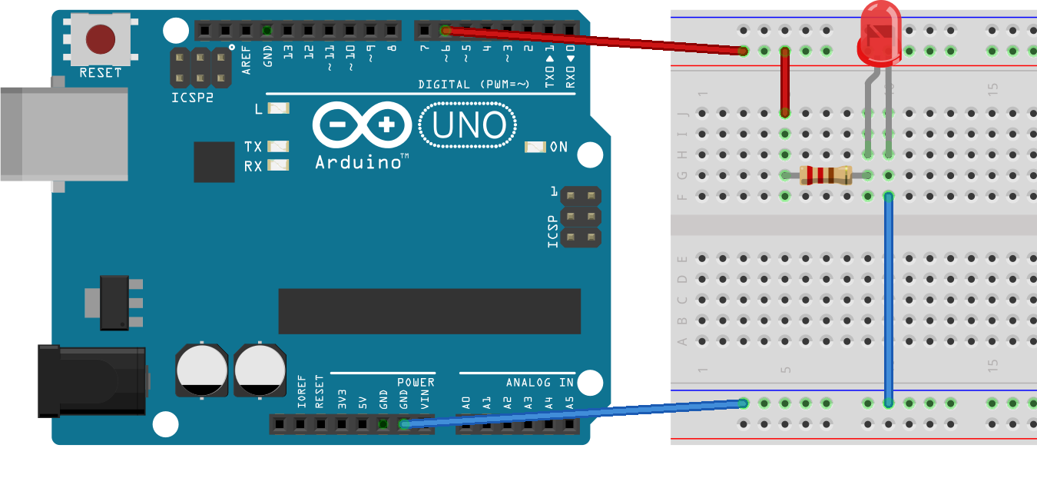
ACTIVITY #1: DIGITAL OUTPUT – Blinking The LED
Connect a wire from pin 6 to a resistor.
Connect an LED to the resistor (long leg first)
Connect a wire from the LED (short leg) to a GND pin.

Slide 34
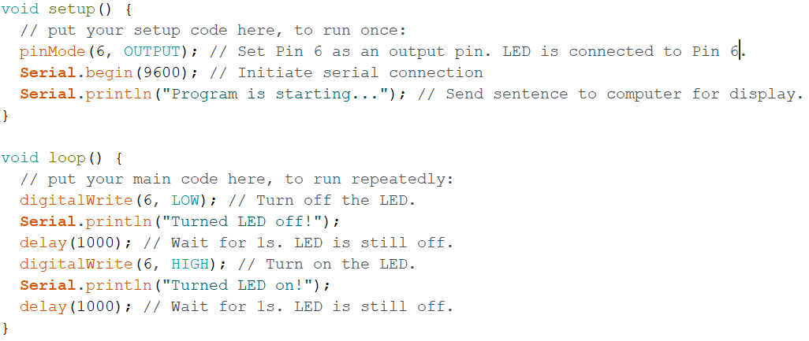
ACTIVITY #1: DIGITAL OUTPUT – Blinking The LED

Slide 35
ACTIVITY #2: ANALOG Output – Fading The LED
Same circuit as before.
Use analogWrite() instead of digitalWrite()
Employ for loops.
Continuous output.
Only pins with a ‘~’ sign next to them support PWM (via hardware)
For the UNO: 3, 5, 6, 9, 10 and 11

Slide 36
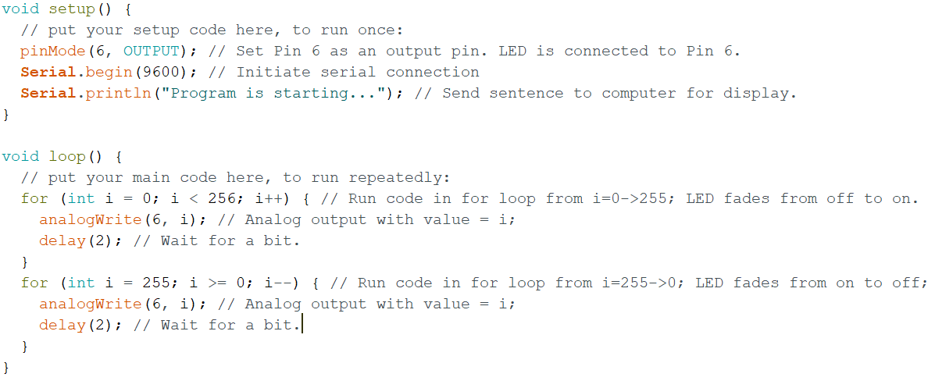
ACTIVITY #2: ANALOG Output – Fading The LED

Slide 37
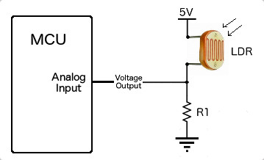
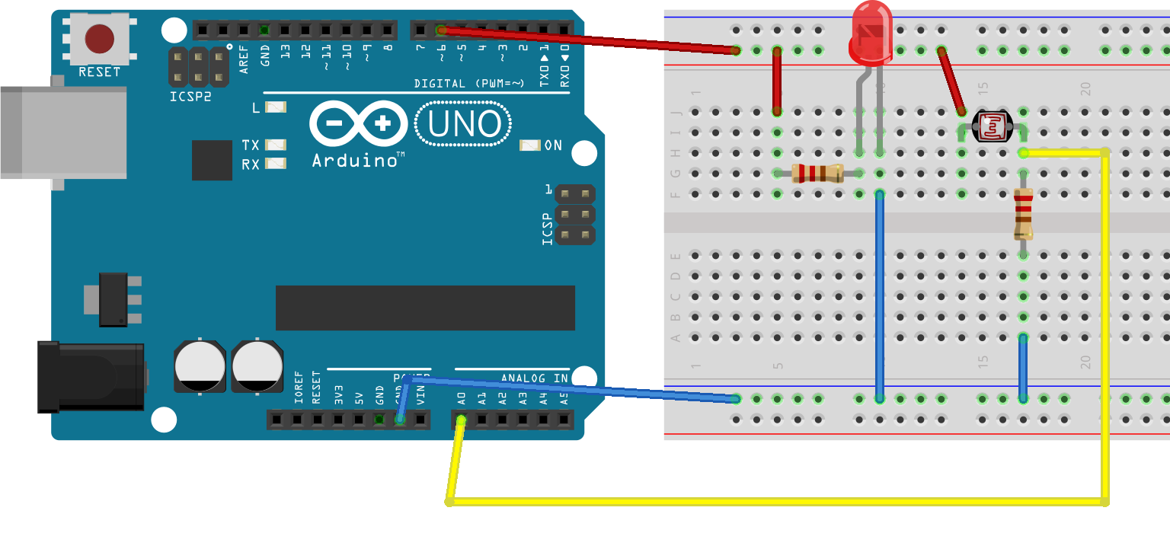
Activity #3: Analog Input – LIGHT SENSOR
Resistance of the LDR changes with light
Due to ratio of R1 and LDR, voltage across R1 will change
Arduino will measure change in voltage and determine whether it is currently dark or bright

Slide 38
Activity #3: Analog Input – LIGHT SENSOR
Logic:
If too dark: turn on light
If too bright: turn off light
What we need is a threshold and check if sensor value is less than or greater than threshold.
Does sensor value increase with light brightness? Or does it decrease?

Slide 39
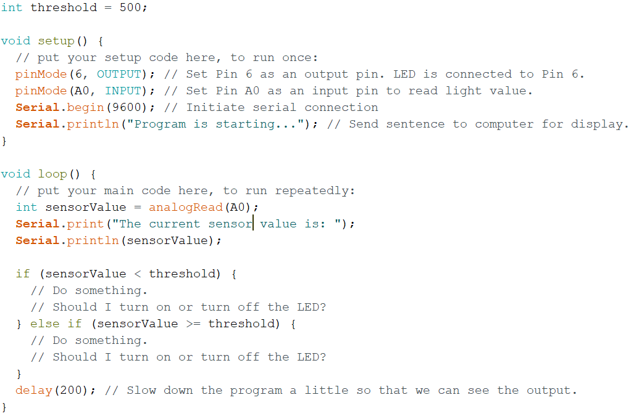
Activity #3: Analog Input – LIGHT SENSOR

Slide 40
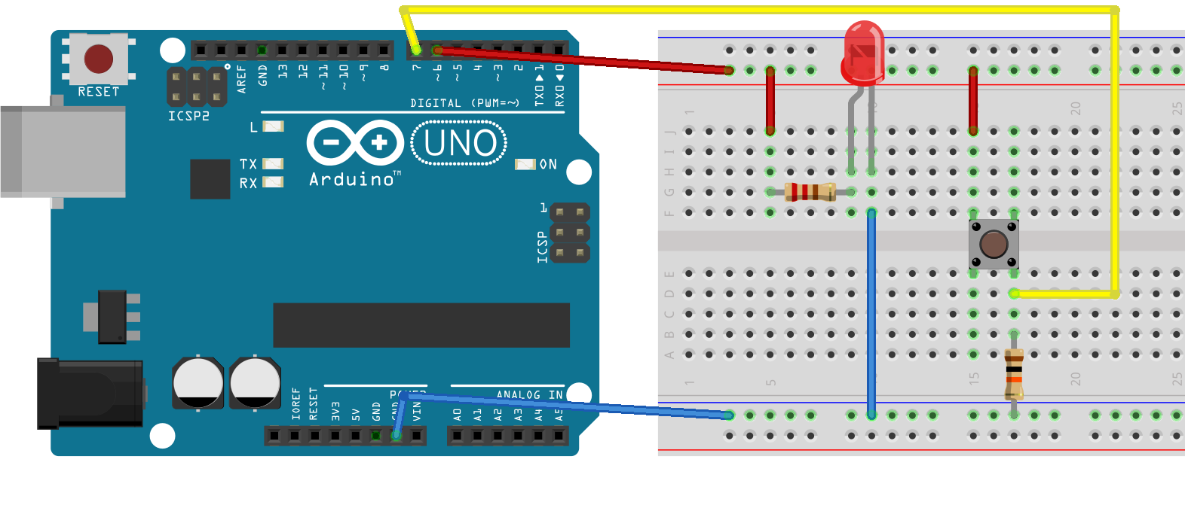
Extra Activity: Digital Input – Buttons
Toggle the state of the LED when button is pressed
Press button once
LED turns on
Press button again
LED turns off
Use digitalRead()

Slide 41
Summary
What is an Arduino?
Programming in C++ (for Arduino)
Basic electronics (analog vs digital)
Inputs and Outputs
Programming the Arduino

Slide 42
Thank You for coming https://tinyurl.com/2018DHWS
Courtesy of SUTD IEEE Student Branch

